Slide 1


Job Market Analysis and Recommendation System
BY:-Dharmendra Kumar
DATE:- AUGUST 2025

Slide 2

Agenda
Ø PROJECT OVERVIEW
Ø DATA ANALYSIS
Ø Top Keyword Correlation with salaries
Ø Growth of Emerging Job Categories Over Time
Ø Demand Forecast For Developer
Ø Remote Work Over Time
Ø Remote Work Forecast
Ø Remote Work Forecast – Scenarios
Ø File Created under Project 8 Folder
Ø app.py
Ø Dashboard

Slide 3


Project Overview
This project focuses on analyzing job market trends and building a personalized job recommendation system for job seekers. By leveraging historical and current job posting data, it identifies high-demand roles, salary trends, and emerging job categories while also forecasting future job market dynamics.

Slide 4
Data Analysis
Key Field
Datasets
TOTAL RECORD= 1000
Job Postings
COLUMNS = 8
MISSING VALUES :-
JOB TITLE/KEYWORDS = 120
Salary
COMPANY = 85
SALARY = 2340
Geographical
LOCATION =640
COUNTRY = 215
Remote Work
JOB DESCRIPTION = 95
EMPLOYMENT TYPE = 310

Slide 5
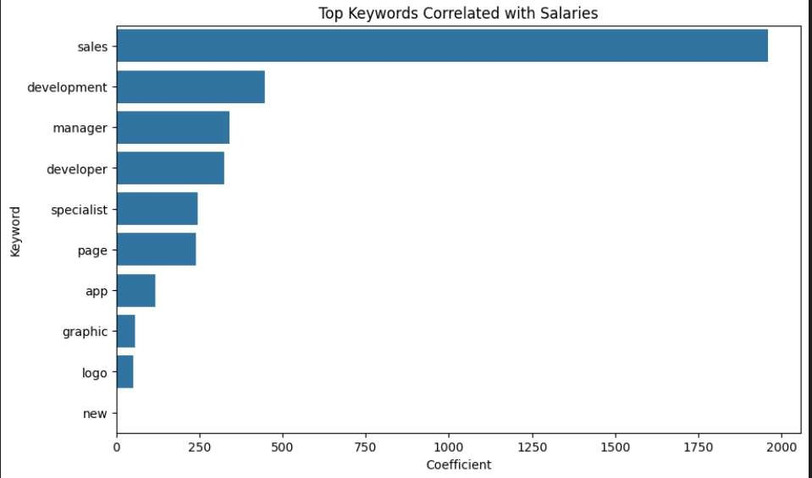
Top Keywords correlation with Salaries
The keyword “sales” has the strongest positive correlation with higher salaries, indicating that sales-related roles are among the most lucrative.
Keywords like “development”, “manager”, and “developer” also show strong salary associations, suggesting that technical and managerial roles are in high demand and well-compensated.
Terms such as “specialist” and “page” fall in the mid-range correlation, reflecting moderate salary potential.
Keywords like “app”, “graphic”, and “logo” have the lowest correlation with salaries, implying that these roles tend to offer lower compensation.
Overall, the graph highlights that business- driven (sales/manager) and technical roles (developer/development) command higher salaries compared to creative/design roles.

Slide 6
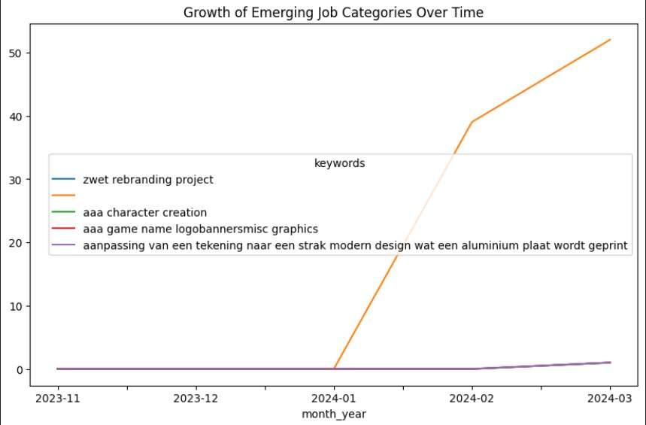
Growth of Emerging Job
Categories Over Time
“aaa character creation” saw the most pronounced spike, starting from zero in early 2024 and rising dramatically.
Categories like “zwet rebranding project,” “aaa game name logobannersmisc graphics,” and “aanpassing van een tekening naar een strak modern design wat een aluminium plaat wordt geprint” remained almost flat or showed only slight growth .
This indicates a significant demand or trend specifically in character creation jobs, outpacing other creative job sectors at the measured time.

Slide 7
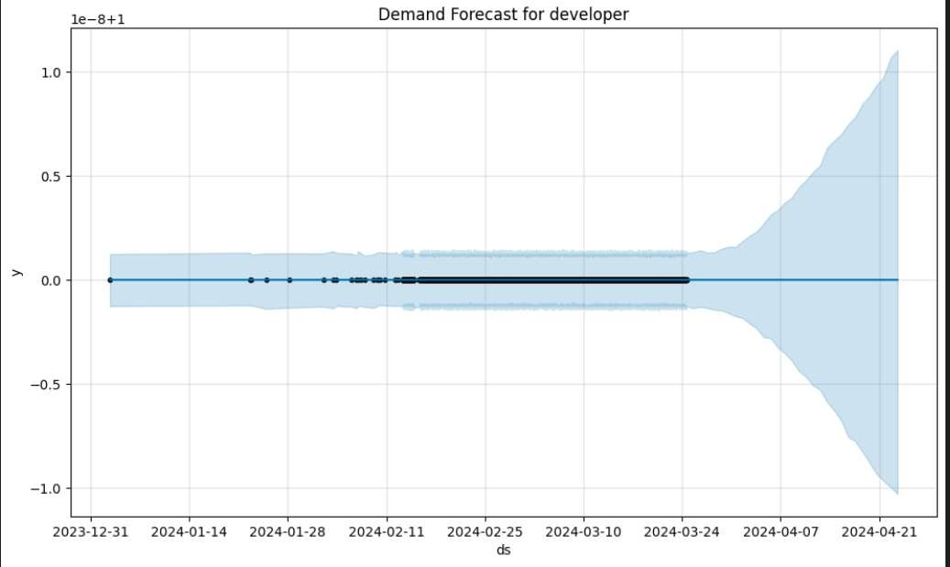
Demand Forecast For Developer
The demand for developers is expected to remain steady and stable in the immediate future, but the forecast uncertainty increases significantly after March 2024, indicating less predictability in developer demand beyond that point.

Slide 8
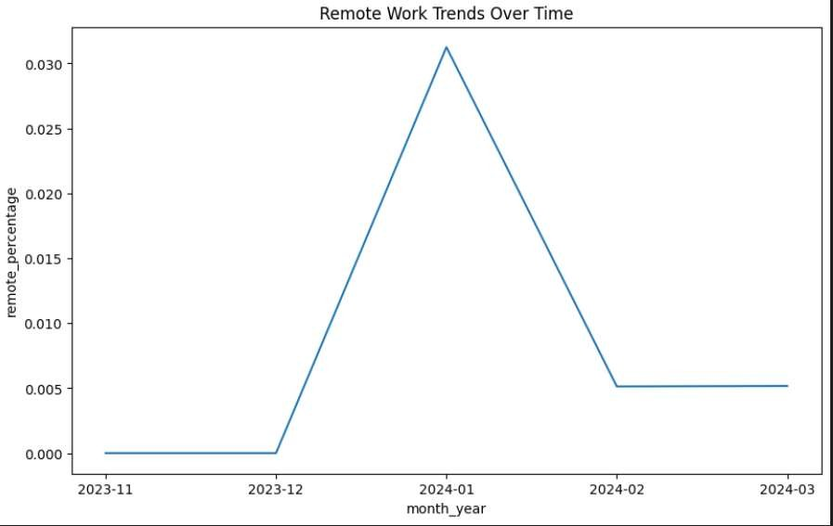
Remote Work Over Time
The percentage of remote work sharply increased around January 2024, peaked, and then quickly declined to stabilize at a lower level by February 2024.

Slide 9
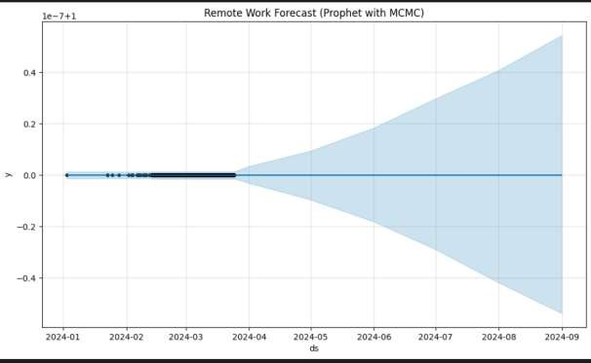
Remote Work
Forecast
The forecast for remote work remains flat in the short term but shows increasing uncertainty about future trends after April 2024, with possible variation both above and below the current level.

Slide 10
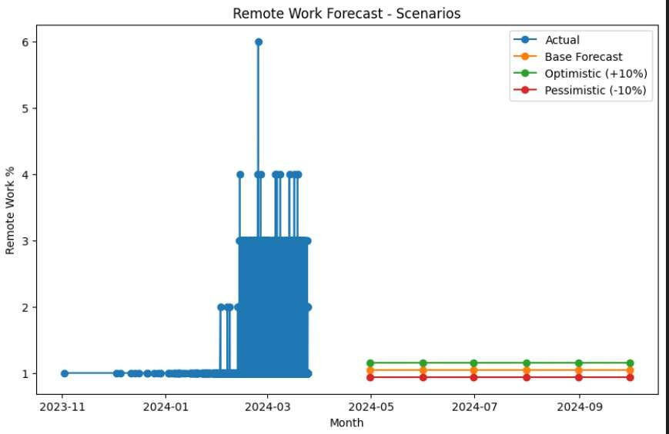
Remote Work Forecast - Scenarios
The actual percentage of remote work showed high volatility early in 2024, but future forecasts suggest it will stabilize near 1%, with only minor variation between optimistic and pessimistic scenarios.

Slide 11
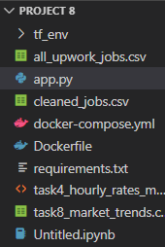
File Created under Project 8 Folder

Slide 12
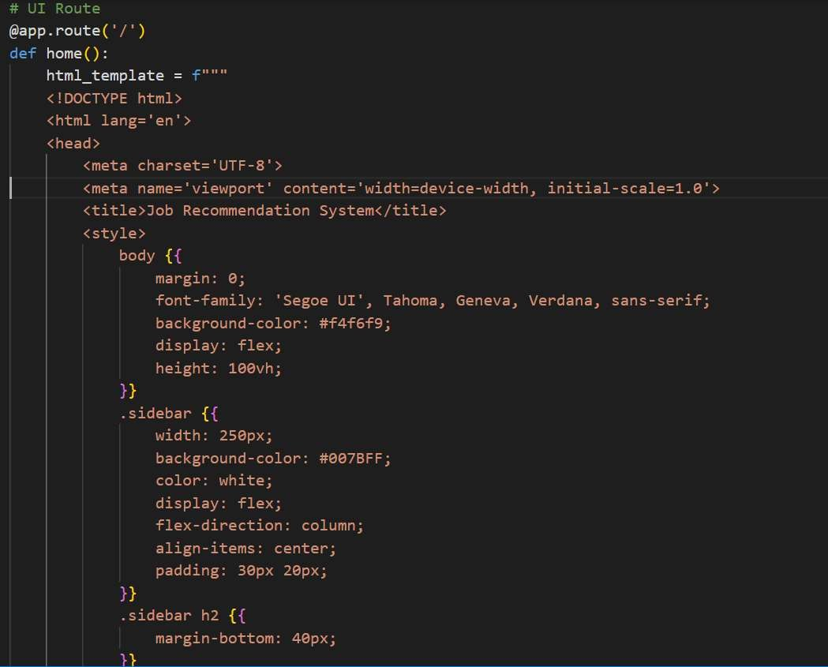
App.py

Slide 13
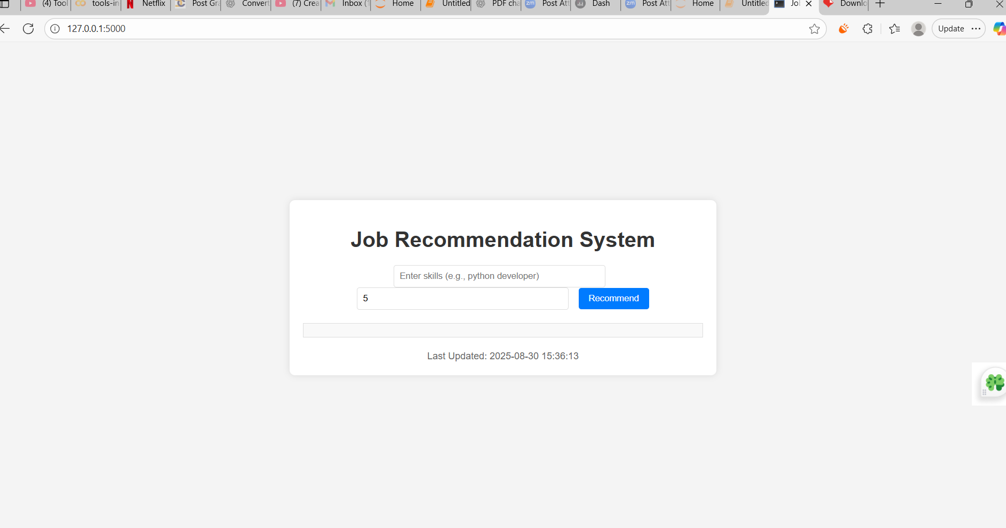
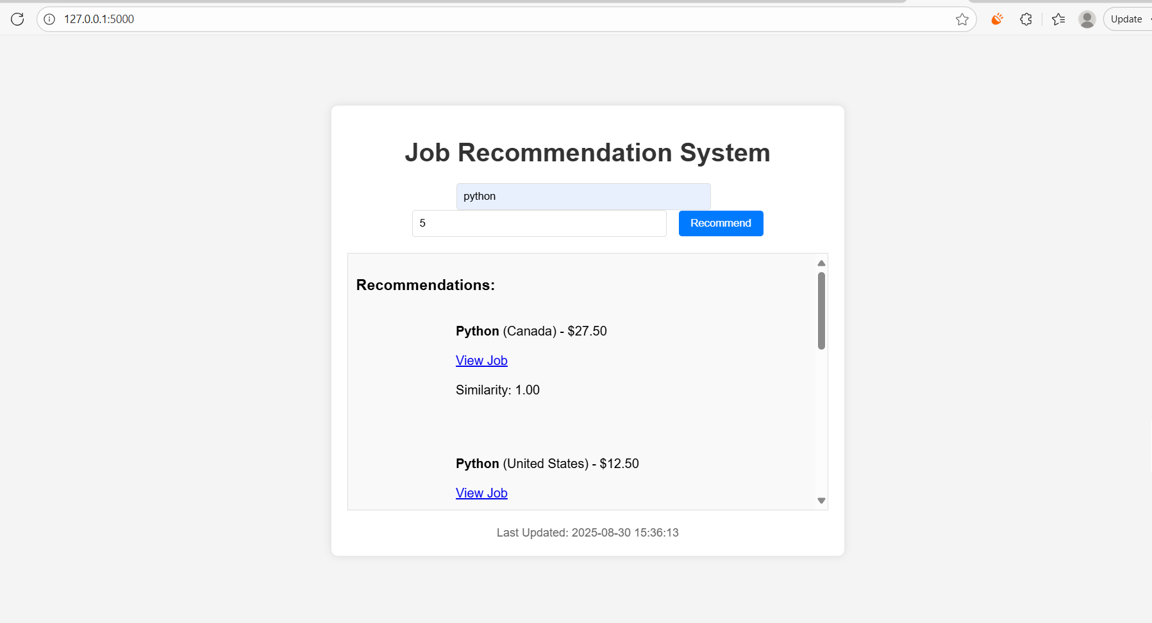
Deployed in Flask

Slide 14
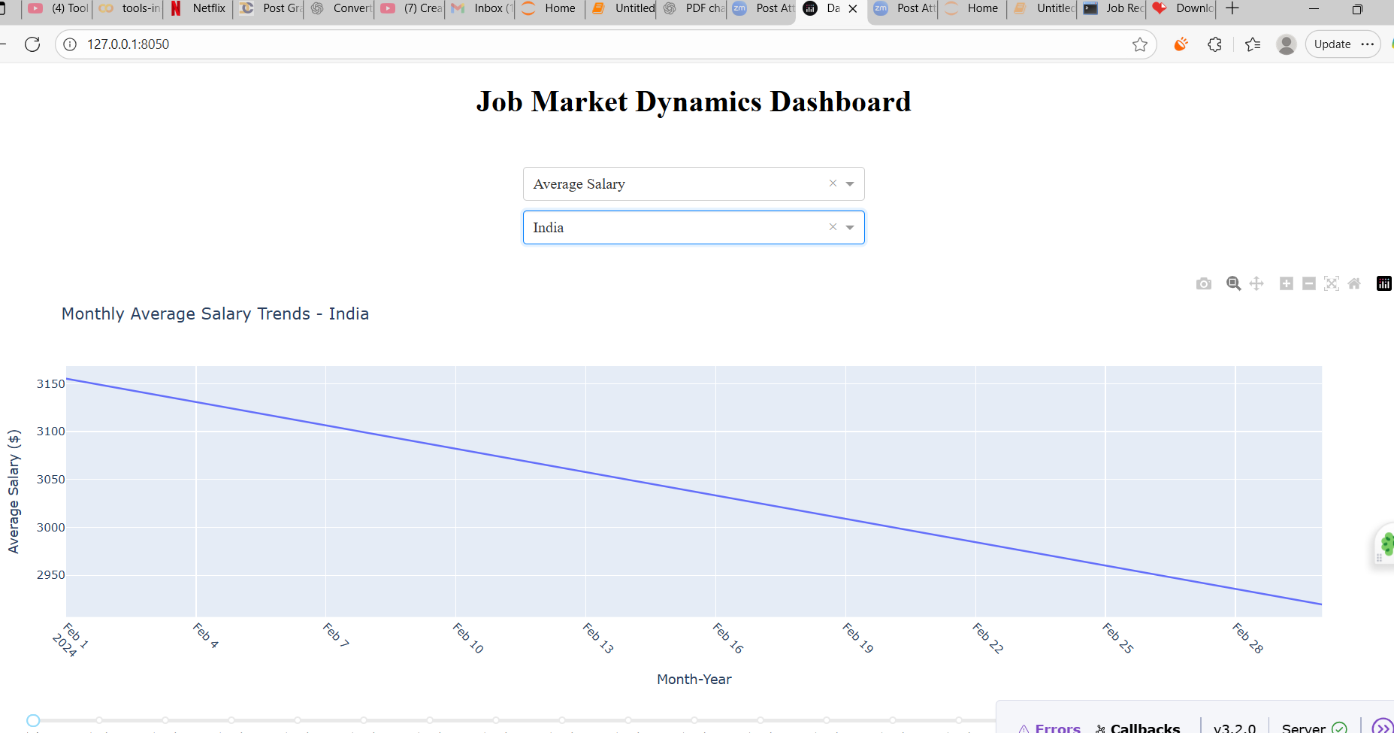
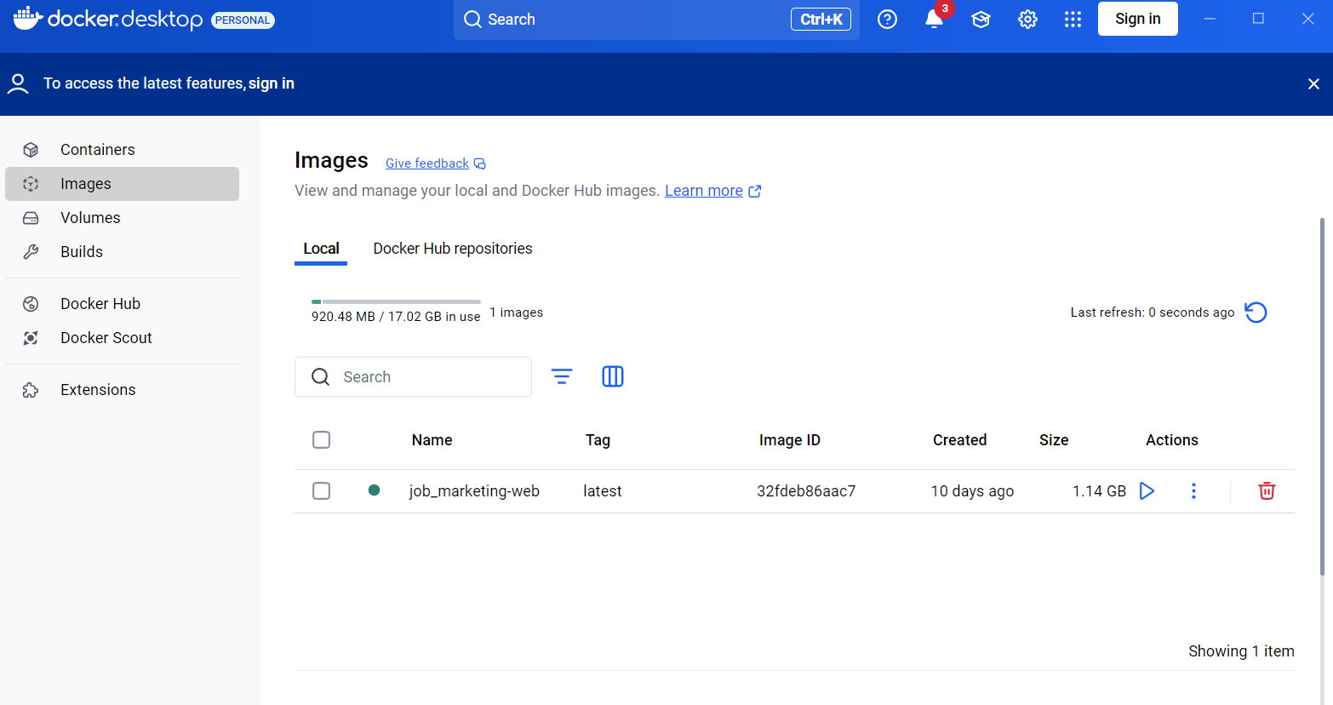
Dynamics Dashboard
Deployed in Docker

Slide 15

Thank You

